Slide 1

Project on Customer Churn Analysis
By G S Kaushik
Guided by
Aakansha Gupta

Slide 2

Introduction
A certain bank in North America wants to perform customer churn analysis, as the credit card business of the bank is not performing very well. Churn analysis will help the bank evaluate the customers who have stopped purchasing the credit card of the bank and figure out measures to reduce the bank's customer loss rate.
As a data analyst, needs to analyze the banks customers' churn data by performing the tasks given in the upcoming slides.

Slide 3

Content
Data Cleansing In python
Dashboard 1
Attrited Customers
Existing Customer holding Silver Card
Attrition Rate wise Marital (M) status and education level (G)
Attrition Rate wise Marital (S) status and education level (D)
Dashboard 2
Female wise Attrition Rate
Attrition of customer having Platinum Card
Existing Customer having dependent 2
Attriting Customer having dependent 3
Attrited Female Customer with 3 dependent counts
Summary

Slide 4
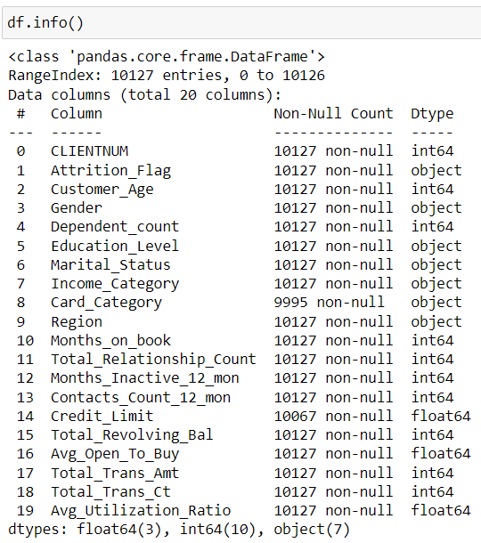
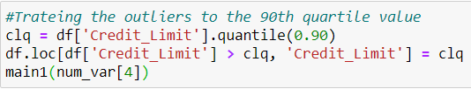
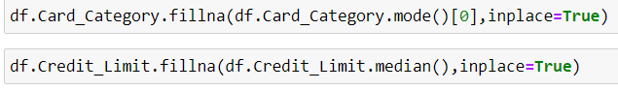
Data Cleansing In python
Loading the data in a given data in python with the help of pandas Library.
Identifying the columns having null values in the data frame and treating it accordingly.
Identifying the outliers in the numerical data and treating it accordingly.
With the help of to_csv downloading the clean data into csv format. That can be loaded into the tableau public for advance visualization .

Slide 5
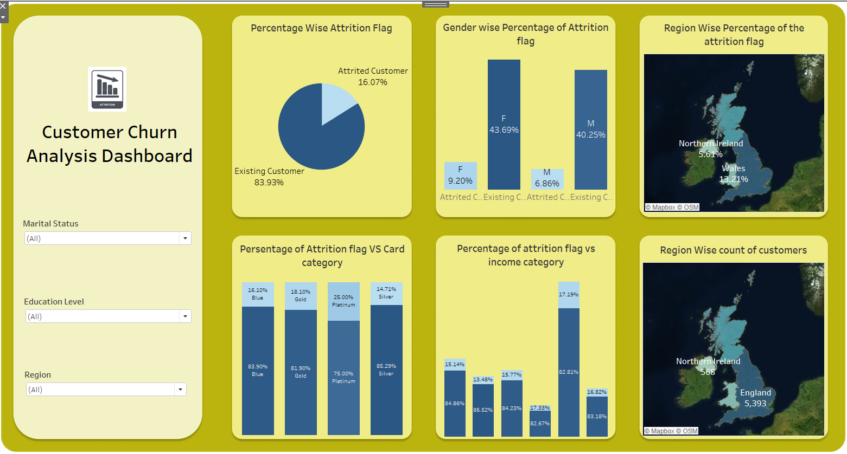

Dashboard 1
This dashboard represent the customer churn.
Pie Chart represents percentage wise attrition flag.
Clustered bar chart 1 represent gender wise percentage of attrition flag.
Graph 1 represents Region wise percentage of the attrition flag.
Stacked bar represents attrition vs card category.
Clustered bar chart 2 represent income category wise percentage of attrition flag.
Graph 2 represents region wise count of customers

Slide 6
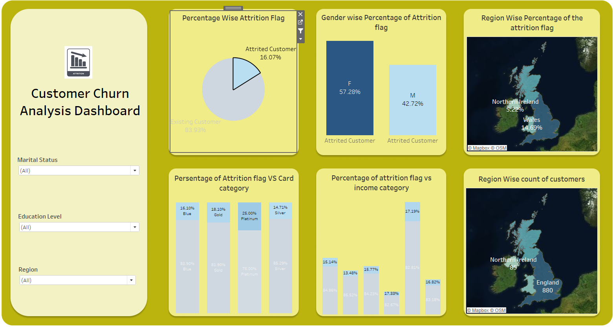
Attrited Customers
16% of the customers have attrited.
In this 16% female has the highest attrition as compared to male. That is around 57.28%.
In England, the customers are more likely to get atterrated

Slide 7
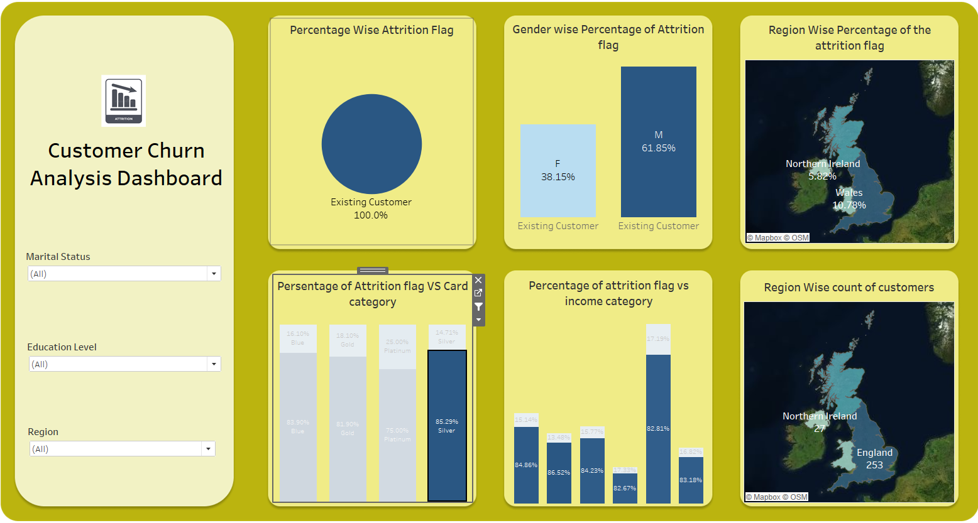
Existing Customer holding Silver Card
Male is the highest retention customer having Silver card.
England has the highest retention that is almost 50%.
North Ireland has the least retention.

Slide 8
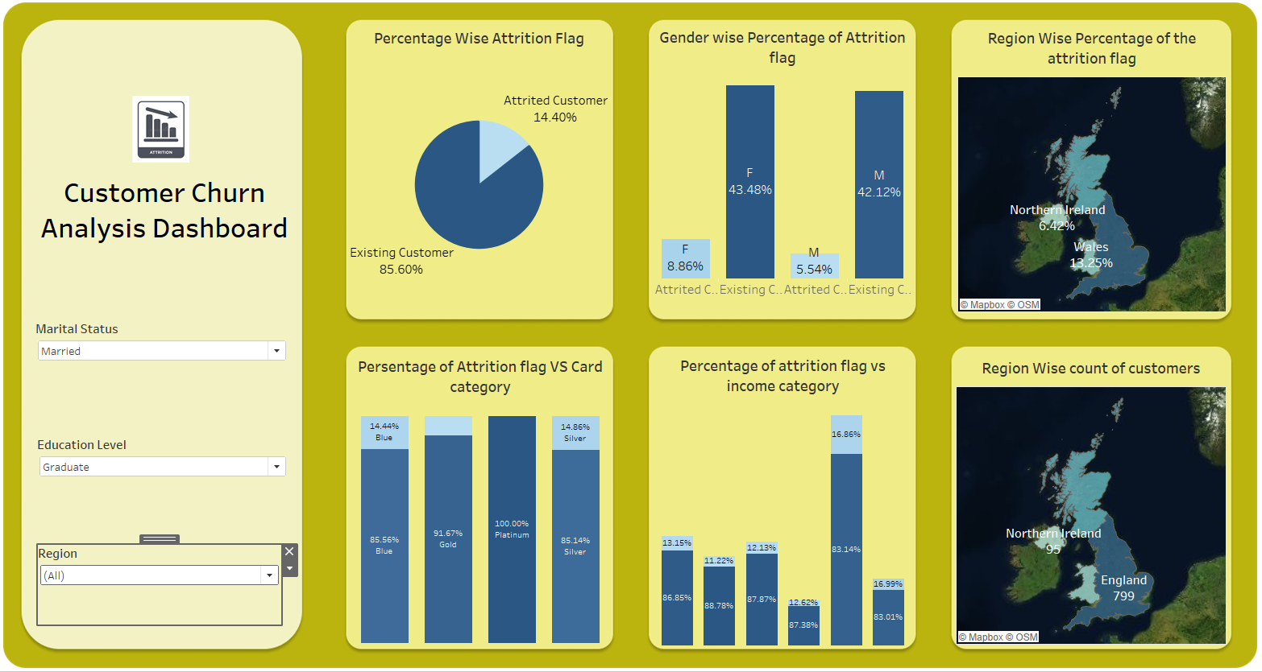
Attrition Rate wise Marital status and education level
Marital status Married and education level Graduate, can observe that the attrite customer is 14.4%.
In which female has the highest Percentage of attrition that is 8.86%.
England region has the highest attired customer.
Blue and silver has the same percentage of attrited customers.
Less the $40k income group has the highest attrition rate.

Slide 9
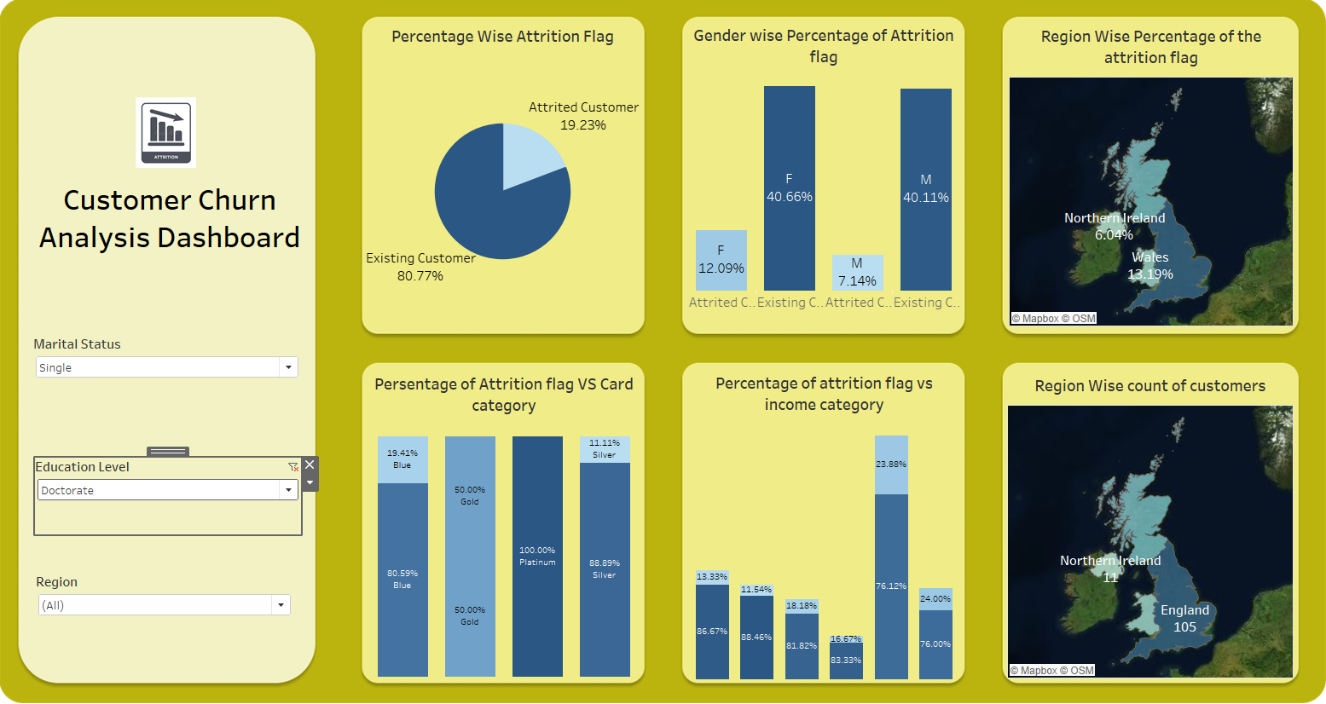
Attrition Rate wise Marital status and education level
Marital status Single and education level Doctorate , can observe that the attrite customer is 19.23%.
In which female has the highest Percentage of attrition that is 12.09%.
England region has the highest attired customer.
Gold has the highest percentage of attrited customers.
Less the $40k income group has the highest attrition rate.

Slide 10
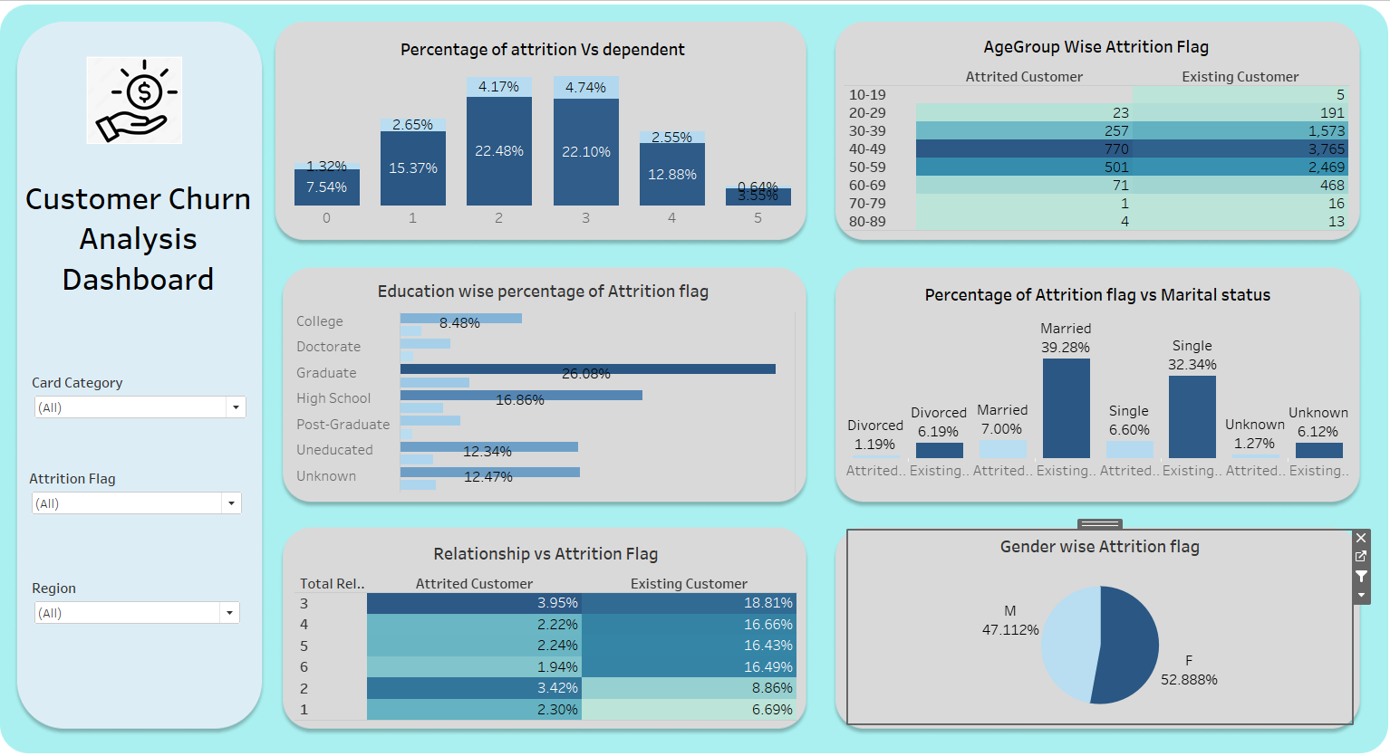
Dashboard 2
This dashboard represent the customer churn.
Pie Chart represents Gender wise attrition flag.
Clustered bar chart 1 represent education wise percentage of attrition flag.
Conditional Formatting 1 represents Age Group wise percentage of the attrition flag.
Stacked bar represents attrition vs Dependent.
Clustered bar chart 2 represent Marital Status wise percentage of attrition flag.
Conditional Formatting 2 Relationship vs attrition flag

Slide 11
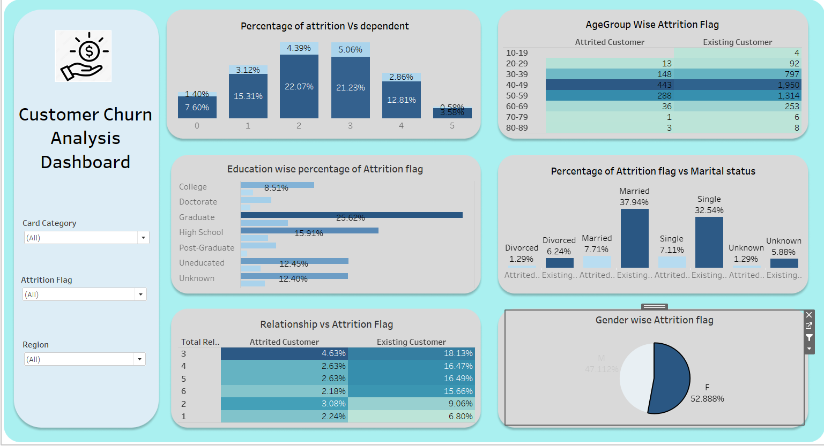
Female wise Attrition Rate
Customer with 3 years relationship has the highest attrition.
Married women has the highest attrition then other marital status.
Graduated customer are more likely to get attrited.
Age group of 40-49 are more likely to get attrited
Customer with 3 dependent has the highest attrition rate.

Slide 12
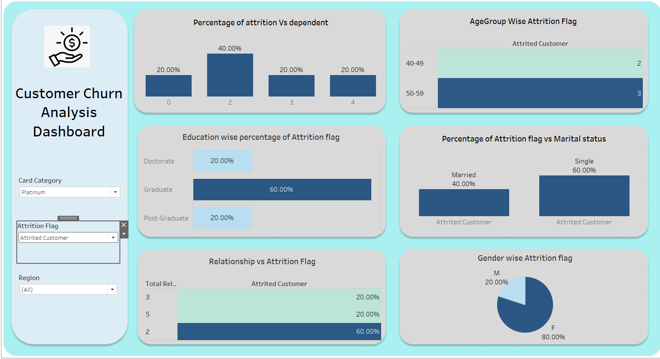
Attrition of customer having Platinum Card
Dependent count 2 has the highest attrition rate.
Age group of 50-59 has the highest attrition.
Graduate has the highest attrition in education level.
In marital status single has the highest attrition.
Customer having 2 years of relation ship has the highest attrition.
Female customer has the highest attrition then male customers.

Slide 13
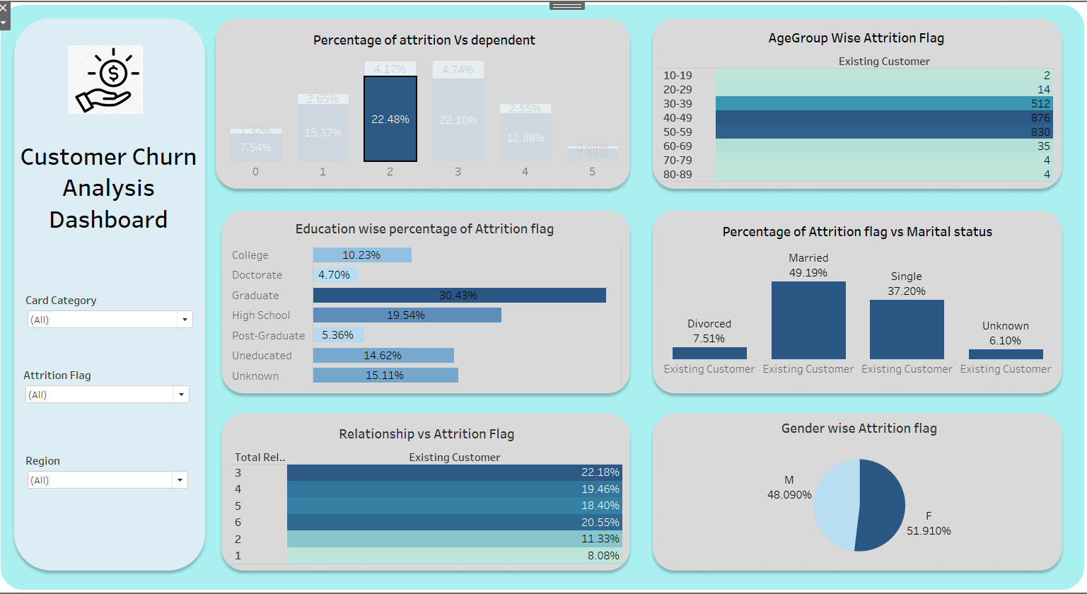
Existing Customer having dependent 2
Age group 40-59 has the highest existing customers.
Married and single has the lest attrition customer.
Education level Like graduate has the highest retention rate.
Customer with more then 3 years with bank has highest retention rate.
Females are more likely to retain in the same bank.

Slide 14
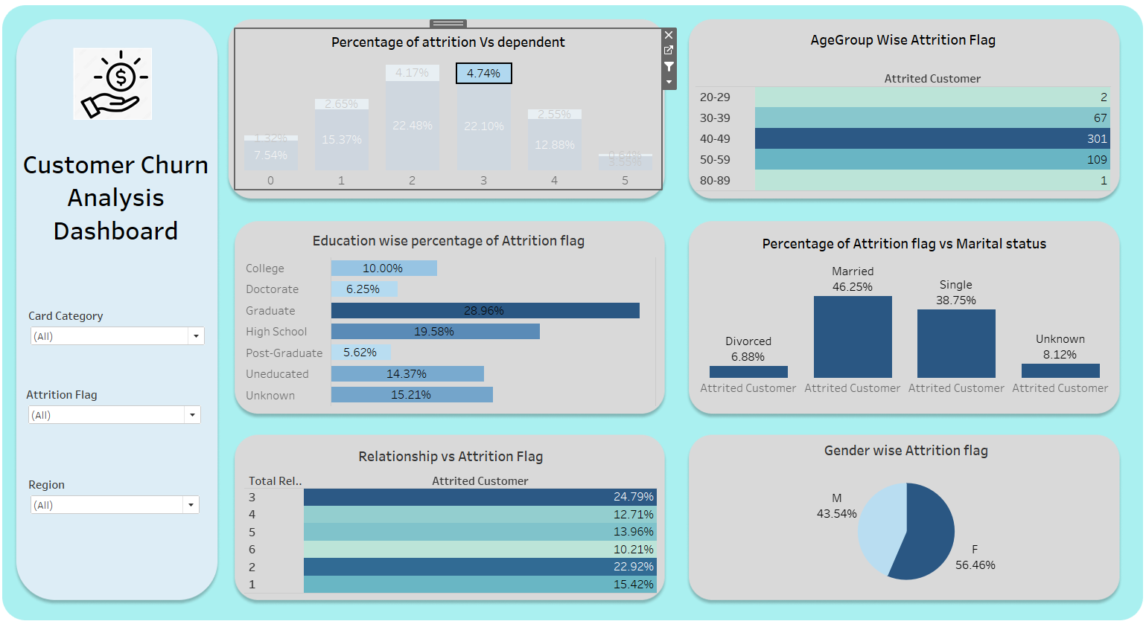
Attriting Customer having dependent 3
Age group 40-59 has the highest attriting customers.
Married and single has the highest attrition customer.
Education level Like graduate has the highest attrition rate.
Customer with 2 and 3 years with bank has highest attrition rate.
Females have the highest attrition.

Slide 15
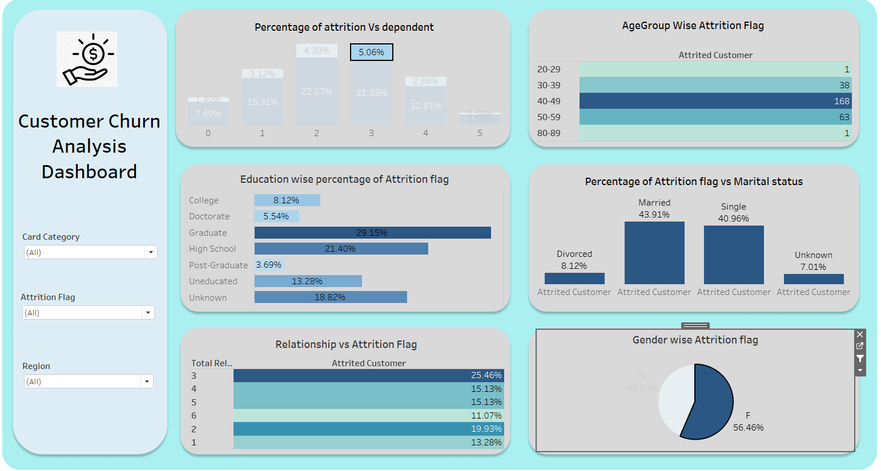
Attrited Female Customer with 3 dependent counts
Age group 40-59 has the highest attrition customers.
Married and single have the same highest attrition customer.
Education level Like graduate has the highest attrition rate.
Customer with 3 years with bank has highest attrition rate.

Slide 16

Summary
As per above analysis the bank should focus more on female customer as they are more in numbers and more likely to get attrited.
People completed with Graduation level education are more. So, the attrition also highest in graduation.
Bank should provide more offers to the married and single clients as they are more likely to get attrited.
Bank must focus more on England region as there are more attrited customer

Slide 17

Thank You

